Slide 1


IT 105: Introduction to Programming
Dr. Manish Khare
Dr. Saurabh Tiwari
Lecture 18

Slide 2
Pointers to array
What are array?
Passing array elements to a function?

Slide 3
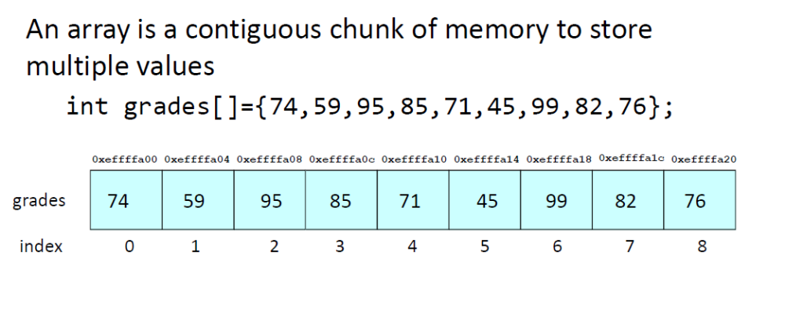

Slide 4
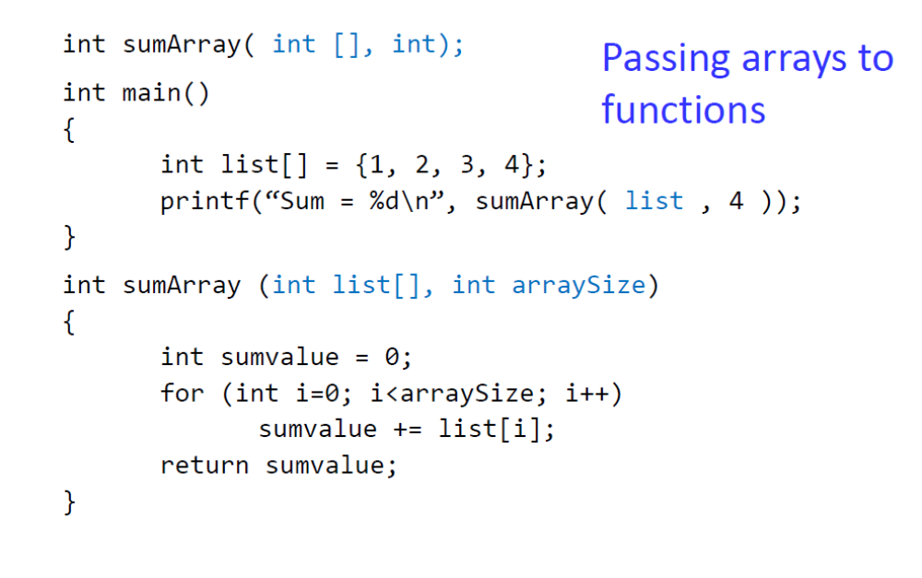

Slide 5
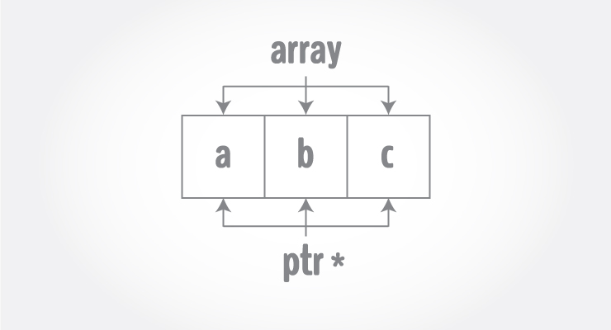

Slide 6
As we all know that pointer is a variable whose value is the address of some other variable i.e. if a variable y points to another variable x means that the value of the variable 'y' is the address of 'x’.
Similarly, if we say that a variable y points to an array n, it would mean that the value of 'y' is the address of the first element of the array i.e. n[0]. So, y is the pointer to array n.

Slide 7
If p is a pointer to array age, means that p (or age) points to age [0].
  int age[50];
  int *p;
  p=age;
The above code assigns p the address of the first element of age.
Since p points to the first element of array age, *p is the value of the first element of the array

Slide 8
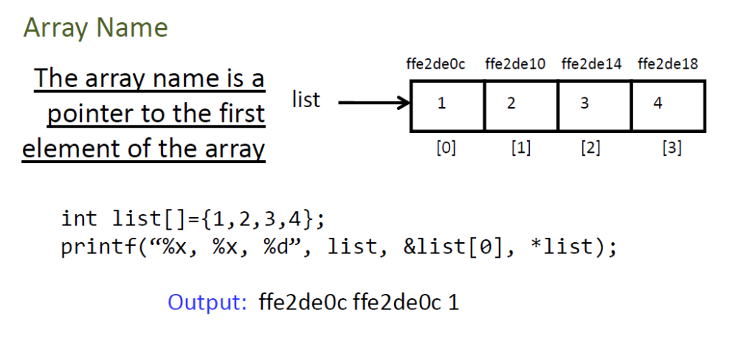

Slide 9
Since *p refers to the first array element, *(p+1) and *(p+2) refers to the second and third elements respectively and so on.
So, *p is age[0], *(p+1) is age[1], *(p+2) is age[2].
Similarly, *age is age[0] ( value at age ), *(age+1) is age[1] ( value at age+1 ), *(age+2) is age[2] ( value at age+2 ) and so on.
Similarly, age is same as &age[0], (age+1) is same as &age[1], (age+2) is same as &age[2], and so on…

Slide 10
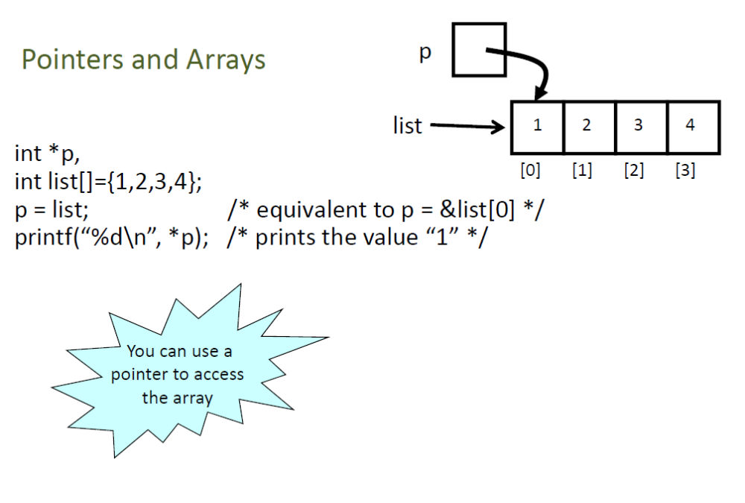

Slide 11
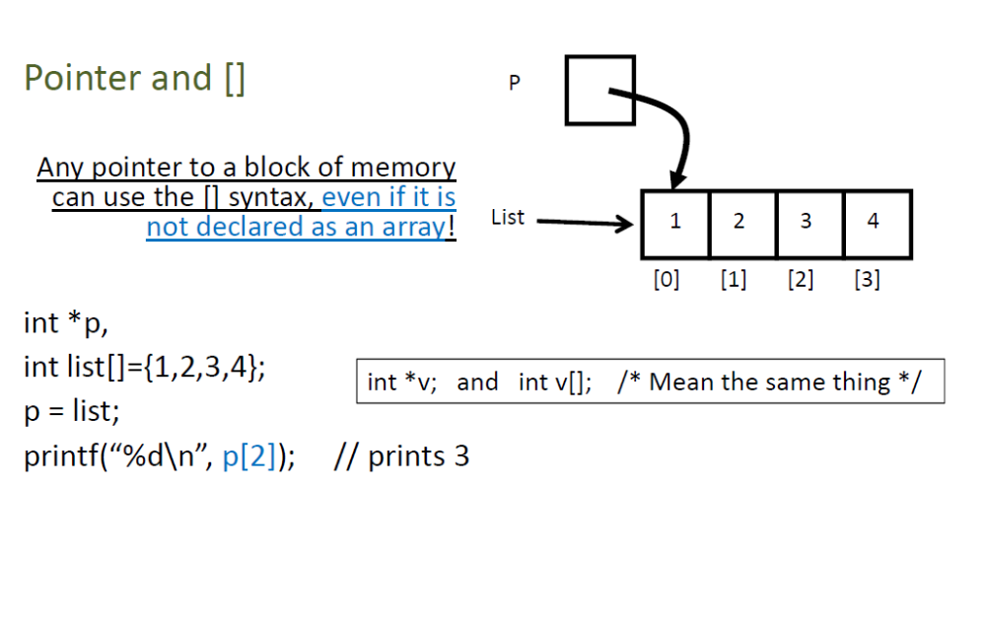


Slide 12
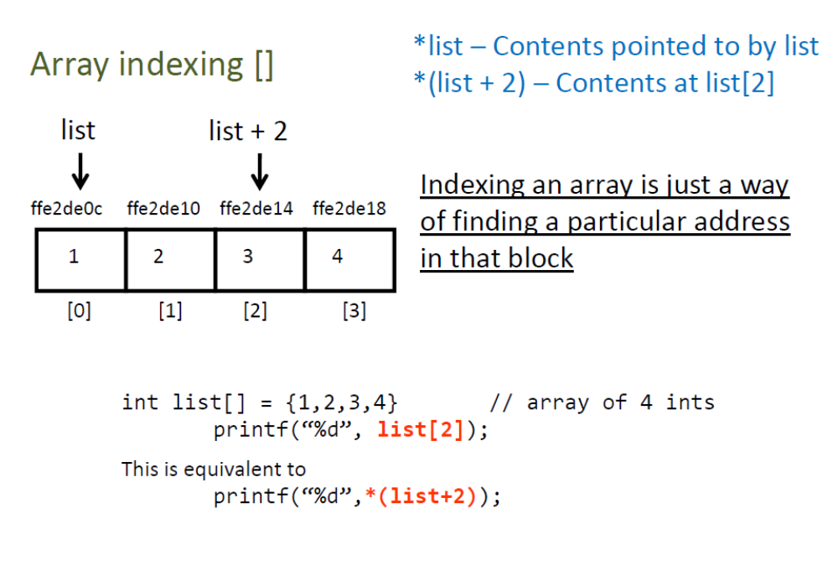

Slide 13
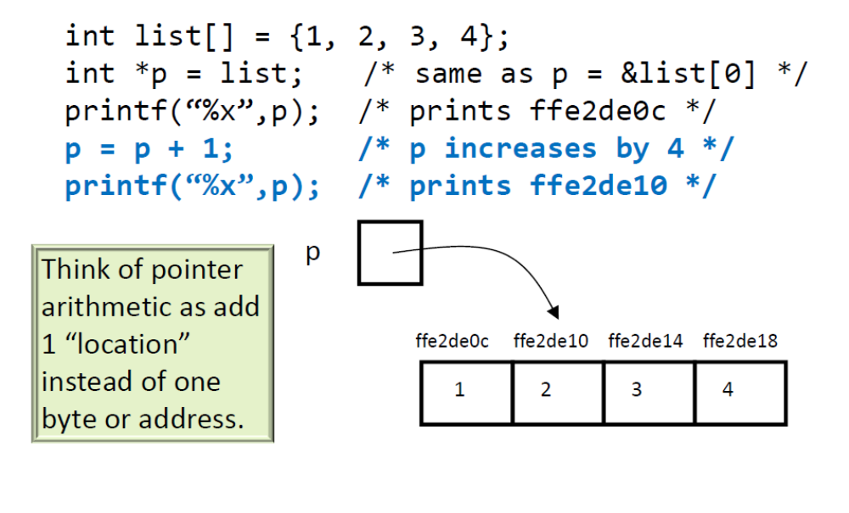
Pointer arithmetic in Array

Slide 14
#include <stdio.h>
int main()
{
float n[5] = { 20.4, 30.0, 5.8, 67, 15.2 }; /* declaring n as an array of 5 floats */
float *p; /* p as a pointer to float */
int i;
p = n; /* p now points to array n */
/* printing the values of elements of array */
for (i = 0; i < 5; i++ )
{
printf("*(p + %d) = %f\n", i, *(p + i) );/* *(p+i) means value at (p+0),(p+1)...*/
}
return 0;
}

Slide 15
*(p + 0) = 20.400000
*(p + 1) = 30.000000
*(p + 2) = 5.800000
*(p + 3) = 67.000000
*(p + 4) = 15.200000

Slide 16
Address mapping
To get the i^{th} element of the one dimensional array we can use the following formula.
  arr[i] = baseAddress + (i x size_of_data_type)
Where, baseAddress is the starting address of the array.
size_of_data_type is the size of the data type.

Slide 17
If we consider the one dimensional character array str of size 6.
Then, baseAddress = 1000 and size_of_data_type = 1
// address of 0th index element of str
str[0] = baseAddress + (i x size_of_data_type)
= 1000 + (0 x 1) = 1000
// address of 1st index element of str
str[1] = 1000 + (1 x 1) = 1001
// address of 5th index element (last element) of str
str[5] = 1000 + (5 x 1) = 1005

Slide 18
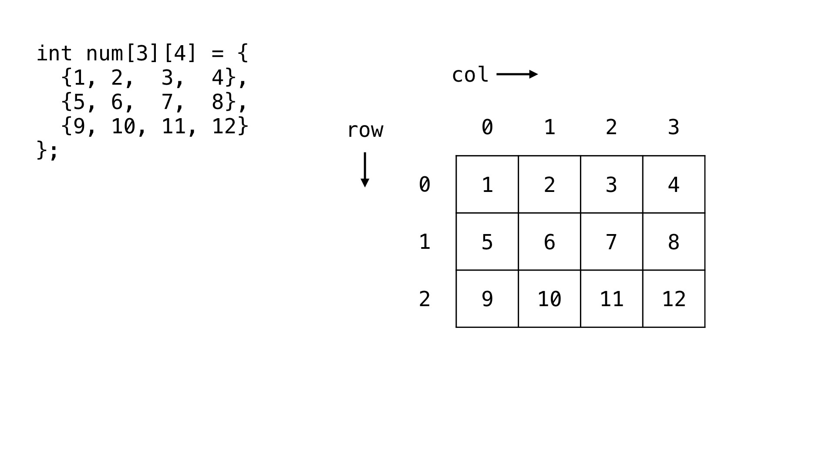
Pointers for 2-D Array

Slide 19
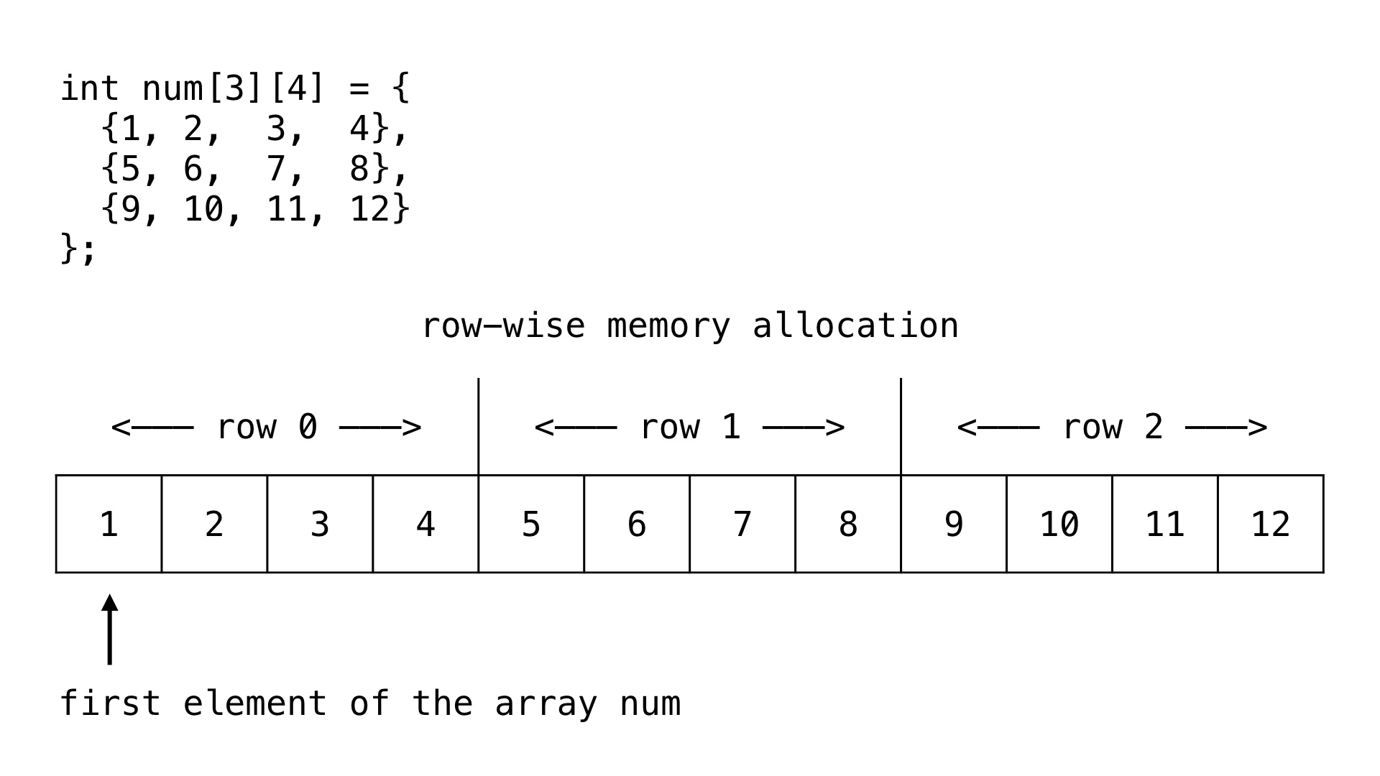
Physically, in one block of memory
Array elements are stored in row major order
Row 1 First, followed by row2, row3, and so on

Slide 20
Create pointer for the 2-D Array
We have created the two dimensional integer array num so, our pointer will also be of type int.
We will assign the address of the first element of the array num to the pointer ptr using the address of & operator.
int *ptr = &num[0][0];

Slide 21
Accessing the elements of the two dimensional array via pointer
The two dimensional array num will be saved as a continuous block in the memory. So, if we increment the value of ptr by 1 we will move to the next block in the allocated memory.
In the following code we are printing the content of the num array using for loop and by incrementing the value of ptr.

Slide 22
#include <stdio.h>
int main(void) {
// 2d array
int num[3][4] = {
{1, 2, 3, 4},
{5, 6, 7, 8},
{9, 10, 11, 12}
};
// pointer ptr pointing at array num
int *ptr = &num[0][0];
// other variables
int
ROWS = 3,
COLS = 4,
TOTAL_CELLS = ROWS * COLS,
i;
// print the elements of the array num via pointer ptr
for (i = 0; i < TOTAL_CELLS; i++) {
printf("%d ", *(ptr + i));
}
return 0;
}

Slide 23
Address mapping
We can compute the address of an element of the array by using the rows and columns of the array. For this we use the following formula.
  arr[i][j] = baseAddress + [(i x no_of_cols + j) x size_of_data_type]
Where, arr is a two dimensional array. i and j denotes the ith row and jth column of the array.
baseAddress denotes the address of the first element of the array. And no_of_cols is the total number of columns in the row.
And size_of_data_type is the size of the type of the pointer. If the type is int then size_of_data_type = 2 bytes and if the type is char then size_of_data_type = 1 bytes.

Slide 24
For example, in the case of num array the baseAddress = 1000, no_of_cols = 4 and size_of_data_type = 2.
So, we can compute the memory address location of the element num[2][3] as follows.
// address of element at cell 2,3
num[2][3] = baseAddress + [(i x no_of_cols + j) x size_of_data_type]
= 1000 + [(2 x 4 + 3) x 2]
= 1000 + [(8 + 3) x 2]
= 1000 + 22
= 1022

Slide 25
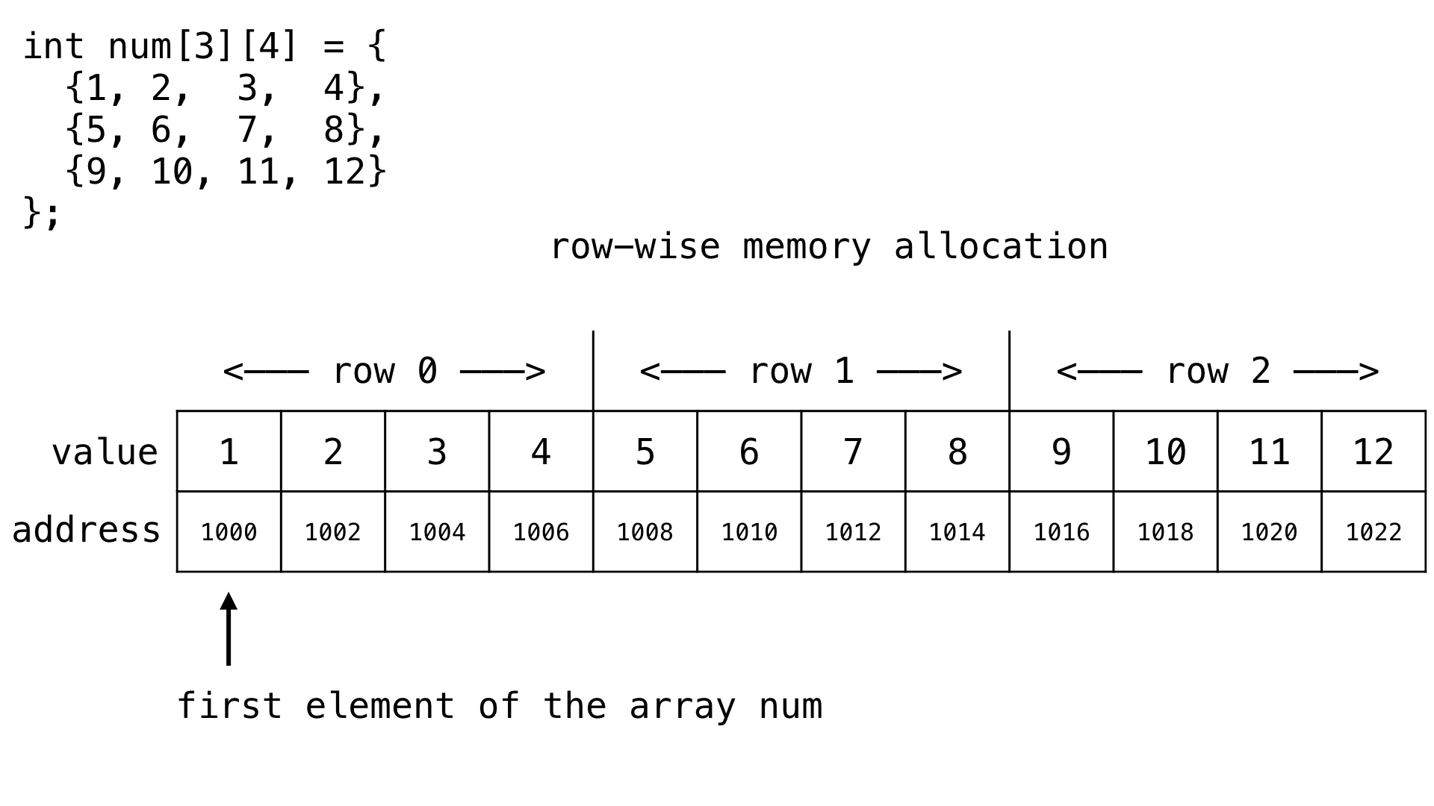

Slide 26
Accessing the value of the two dimensional array via pointer using row and column of the array
If we want to get the value at any given row, column of the array then we can use the value at the address of * operator and the following formula.
  arr[i][j] = *(ptr + (i x no_of_cols + j))
Where, arr is a two dimensional array and i and j denotes the ith row and jth column of the array.
ptr holds the address of the first element of the array.
And no_of_cols denotes the total number of column in the row of the array.

Slide 27
#include <stdio.h>
int main(void) {
// 2d array
int num[3][4] = {
{1, 2, 3, 4},
{5, 6, 7, 8},
{9, 10, 11, 12}
};
int
ROWS = 3,
COLS = 4,
i, j;
// pointer
int *ptr = &num[0][0];
// print the element of the array via pointer ptr
for (i = 0; i < ROWS; i++) {
for (j = 0; j < COLS; j++) {
printf("%d ", *(ptr + i * COLS + j));
}
printf("\n");
}
return 0;
}

Slide 28
int num[3][4] = {{1, 2, 3, 4}, {5, 6, 7, 8},{9, 10, 11, 12} };
num: pointer to the first element of the 2-D Array
num[0]: pointer to the first row of the 2-D Array
num[1]: pointer to the second row of the 2-D Array
*num[1]: is the address of element num[1][0]

Slide 29
int num[3][4] = {{1, 2, 3, 4}, {5, 6, 7, 8},{9, 10, 11, 12} };
Indexing: num[i][j] is same as
*(num[i]+j)
(*(num+i))[j]
*((*num+i))+j)
*(&num[0][0]+4*i+j)

Slide 30
STRING

